Slide 1
Oil market outlook: The big questions facing the industry and what it means for Southern Africa
FIASA
Daniel Evans, Vice President, Global Head of Fuels and Refining Research
July 24, 2025
Notes:
I want to tee up some of the discussions we’ll have later today by sharing our view on some of the issues our clients are telling us are important and then bringing it back to what it means for this region

Slide 2
The big questions facing the industry and what it means for Southern Africa
1
How low can the oil price go?
2
Does a refining downcycle create supply risk for southern Africa?
3
Has the energy transition stalled?
Notes:
How low can the price go? If $50 or $60/b oil isn’t part of your thinking, it probably should be. We believe that the fundamentals point towards lower oil prices. That can be good news for importing countries due to lower cost of supply, but it’s also a risk for producing countries as upstream players will typically look to tighten their belts and seek more attractive fiscal terms in periods where prices are lower.
On the refining side, we believe we’re moving into a downcycle…a period of lower margins that will trigger closures. But the transition is set to be bumpy with volatile prices in the near term and a need to rethink supply in the longer term
The energy transition remains important but the importance of decarbonization relative other priorities is being reset.

Slide 3
How low can the oil price go?

Slide 4
Bearish fundamentals point towards lower prices | Crude oil production growing faster than demand in 2025
Data compiled June 27, 2025.
Condensate is included in crude oil production and demand. Crude oil demand is refining runs and direct use of crude oil.
Source: S&P Global Commodity Insights.
Notes:
Fundamentals are extremely weak and point towards lower prices

Slide 5
Tariffs are jeopardizing economic growth | Tariffs are at their highest level for over 100 years and uncertainty is soaring
Announcements regarding US tariffs
Beginning of COVID-19 pandemic
Source: USITC DataWeb, S&P Global Ratings Economics, Data through 2025 YTD.
Note: This time represents Data Web a specific measuring of tariffs as not all goods are subject to tariffs. This share of duties on all imports does not include USMCA compliant.
© 2025 S&P Global.
Notes:
The macro environment points towards lower economic growth and oil demand
Tariffs are likely to be higher than at any time since WW2
Uncertainty is high – Consumers are not spending. Investors are not investing.

Slide 6
How low can oil demand go? | Oil demand has only contracted twice in the last 30 years
Dated Brent
4Q08: $55/b
1Q09: $44/b
Dated Brent
2020: $42/b
Notes:
Our demand outlook has been revised down to 0.8MMb/d (from 1.3 MMb/d)
Lower than any time since the Asian financial crisis (excluding the pandemic and financial crisis)
Low because of cyclical and structural factors (tariffs are hitting diesel and jet demand and Evs and LNG are hitting Chinese road fuel demand)

Slide 7
OPEC is increasing production even as the oil price falls | Will OPEC+ row back on planned production increases?
Notes:
Big story is on the supply side
OPEC has shifted strategy and is no longer defending price
Will they stick to their guns even if prices weaken?

Slide 8
OPEC+ increases: Gulf-3 add 500,000 b/d in two months | An accelerated timeline would add ~2MMb/d of production by September
Will the V8 increase production faster than previously planned?
Notes:
We think so
Current plans will see them put 2 million b/d of oil into an already oversupplied market

Slide 9
Will US production fall to quickly balance the oil market? | Only if the price falls far enough
If WTI falls to $50/b, US production could fall more than 1MMb/d in 12 months
At a steady WTI price of $50/b, US Lower 48 onshore production could decline by more than 1 million b/d over the course of a year, assuming the reinvestment rate of the upstream industry is unchanged from our current assumption of 60%. The reinvestment rate is the share of cash flows reinvested by the industry in upstream operations. In a $50/b oil world, we believe US onshore operators would continue to prioritize returns to shareholders and thus reduce their activity to keep their reinvestment rate from rising to a large degree.
Data compiled April 25, 2025.
WTI prices are shown in chart legend and are in per-barrel terms. Reinvestment rate is the share of cash flows reinvested by the industry in upstream operations. A reinvestment rate above 100% implies taking on debt to fund upstream operations.
Source: S&P Global Commodity Insights.
Notes:
How will the market rebalance?
US production can be reactive, but prices need to be lower than they are now for US production to adjust
Will we get lower prices?

Slide 10
Inventories to build rapidly in the second half of 2025 | An accelerated unwinding of production cuts will see inventory soar
Data compiled June 27, 2025.
Data is weekly.
Source: S&P Global Commodity Insights.
Notes:
That will see inventories soar and prices come down.
But will they come down enough to see the supply side correct?

Slide 11
Fragile prices | More supply and less demand will lead to lower prices…
…faster unwinding of OPEC+ cuts could see Brent below $50/b
2025: $68/b
2026: $58/b
1H25
$72/b
2H25
$64/b
1H26
$56/b
2H26
$60/b
Notes:
We believe prices could head south of $60/b for a prolonged period
Lower for longer? If demand growth keeps weakening that is a possibility due to pipeline of projects coming online

Slide 12
Does a refining downcycle create supply risk for southern Africa?

Slide 13
Transition ahead | Transportation fuel balances are set to become looser as demand growth slows and new capacity is brought online
Impact of announced closures in 2025 and 2026
Balanced market: Average cracks and margins
Change in demand
Change in supply
Transition
Demand outpacing supply.
High margins.
Excess supply.
Low margins.
Refinery closures.
Notes:
We’re transitioning into a downcycle as capacity increases and demand growth slows
Ultimately that will trigger closures and require a rethink on reliable future sources of supply
But the transition will also create price volatility in the ST

Slide 14
Nameplate capacity increasing | 3 MMb/d of capacity currently starting up, ramping up or shutting down
Slower ramp-up of Dangote RFCC until Q1 2026
Exxon Mobil Corp. began the startup of its Beaumont expansion in Q1 2023
LyondellBasell Industries NV Houston shutdown in Q1 2025; Phillips 66 shutdown in Q4 2025
Valero Energy’s Benicia refinery to close by April 2026
Includes Grangemouth, Gelsenkirchen and Wesseling
Data compiled June 2025.
CIS = Commonwealth of Independent States.
Historical capacity additions represent global sum of new projects and incremental capacity creep at existing refineries. Closures of crude distillation unit (CDU) capacity include biorefinery conversions. Chart reflects initial startup of CDU capacity; see slide 16 for specific timing of production ramp-up.
Source: S&P Global Commodity Insights.
Notes:
The source of that volatility is the big changes in terms of both supply additions and closures
On the supply side we’re adding and taking away large amounts of capacity

Slide 15
The two sides of supply | The average size of refineries starting up and shutting down is increasing, leading to greater supply-side uncertainty
Average size of new refineries
Average size of refineries closing down
Notes:
The increasing size of startups and closures means bigger changes in supply…more volatility

Slide 16
Margins | Despite weakening demand, we see supply-side support for cracks and margins in 2025
Notes:
That’s what we’re seeing right now
Tight gasoil markets despite weak demand
So although the overall trajectory is towards lower margins, there could be surprises as closures temporarily tighten the market

Slide 17
Dangote matters | Dangote startup will be a big driver of gasoline and diesel balances and cracks
Cumulative change in supply
Other refineries
Dangote
Data compiled June 2025.
Middle Eastern refineries include Jizan, Al Zour and Duqm. European refineries include Grangemouth, Wesseling, Gelsenkirchen and Livorno. Houston refers to LyondellBasell; Los Angeles refers to Phillips 66. Some refineries’ supply may reflect incremental production elsewhere because of feedstocks produced from the new capacity. Please note that mainland China’s supply changes have been added in this month’s report.
Source: S&P Global Commodity Insights.
Notes:
The trouble that Dangote has run into are a good example of how precarious the balances are
If project startups are delayed and closures accelerate, the market can quickly become tight

Slide 18
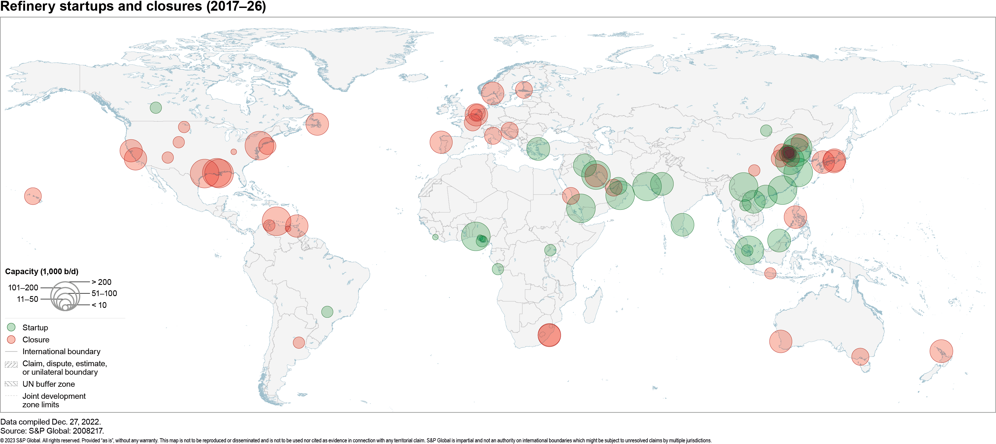
Closures | We expect almost 1 million b/d of closures by the end of 2025
Several closures have been announced and yet the exact timing remains uncertain
2026: (145,000b/d)
Benecia (145,000b/d)
2024: (198,000b/d)
Livorno (84,000b/d)
Yamaguchi (114,000b/d)
2025: (785,000b/d)
Gelsenkirchen (85,000b/d)
Grangemouth (145,000b/d)
Houston (268,000b/d)
Wesseling (148,000b/d)
LA (139,000b/d)
Notes:
We expect more closures
3 MMb/d by end of 2030

Slide 19
Africa is on a different path | The African continent will have the fastest pace of demand growth over the next decade
Notes:
This contraction creates a challenge for Africa because it’s on a different trajectory to other regions
Demand is growing at a faster rate than anywhere else

Slide 20
Macro trends support robust demand growth | Population growth and trek out of energy poverty will support demand growth
Notes:
Growth is underpinned by demographic growth
Africa’s population will grow by more than half a billion people in the next 15 years (every other person born will be an Africa)
The working age population will grow
The region is also incredibly energy poor
Energy use per capita is extremely low
As people become more affluent, and economies expand, we expect use per capita to increase.
Even modest increases in consumption per capita will create a huge upside for demand.

Slide 21
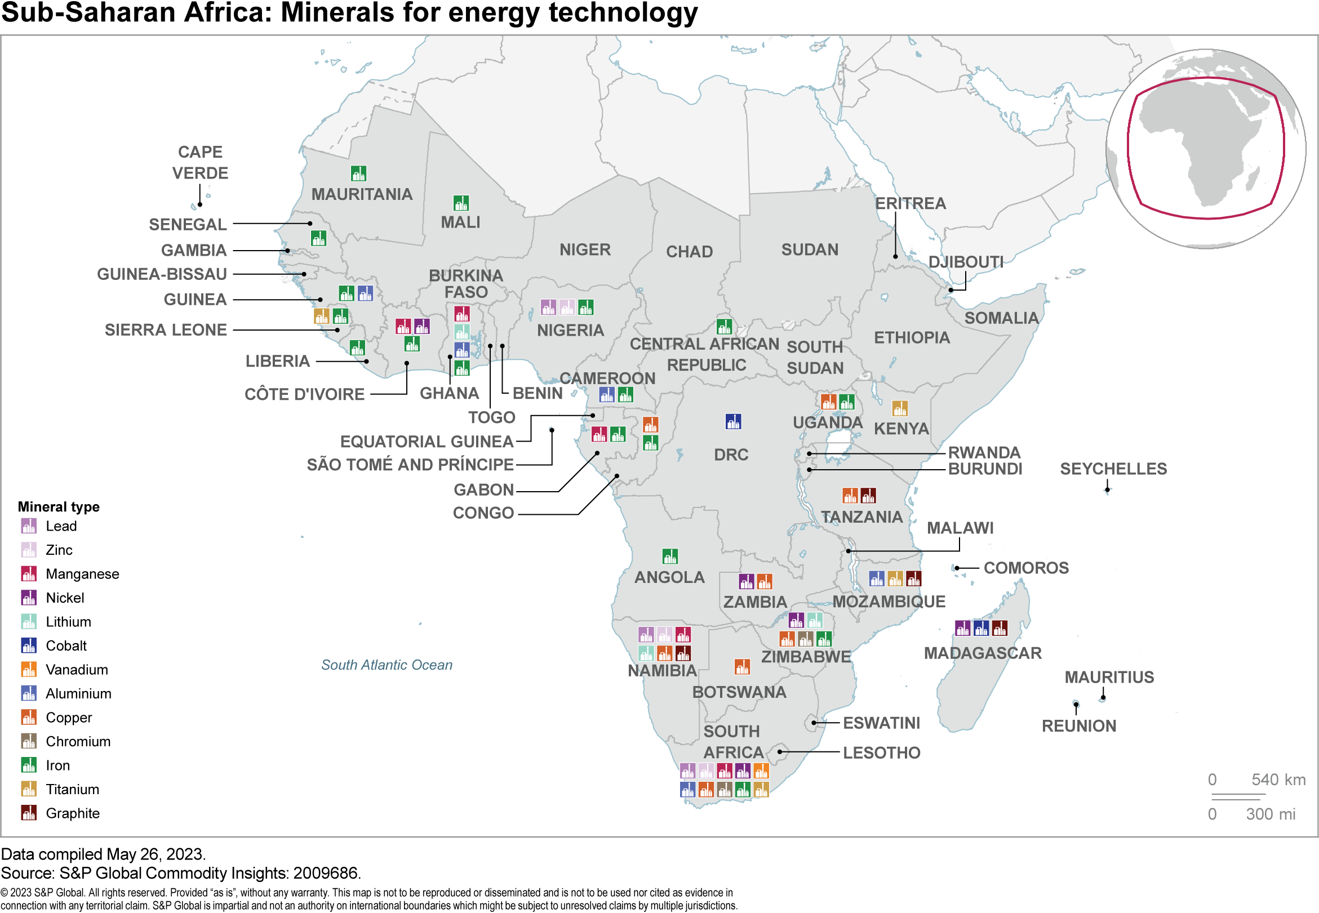
Energy transition to support African oil demand | Mining activity to surge on the back of energy transition investments
DR Congo has the world’s largest cobalt reserves.
Zambia is one of the largest copper producers on the continent.
Zimbabwe is one of the few African countries with identified lithium reserves and also produces large quantities of nickel.
Botswana produces large quantities of nickel.
Notes:
Even the energy transition will support demand growth
The continent is rich in the metals and minerals required to support the energy transition
Mining activity is set to increase and that will support demand for gasoil
So unlike other regions where the energy transition is eroding demand for oil, in Africa it will support demand.

Slide 22
Refining stagnating as demand surges | Is Dangote an anomaly or a blueprint for future refining development in Africa?
Notes:
Although demand is growing supply isn’t
Demand has more than doubled since 1990 but refining capacity has been flat
Is Dangote an anomaly?
Even if it’s not, there are no big projects under construction so in the medium-term the gap between supply and demand will widen

Slide 23
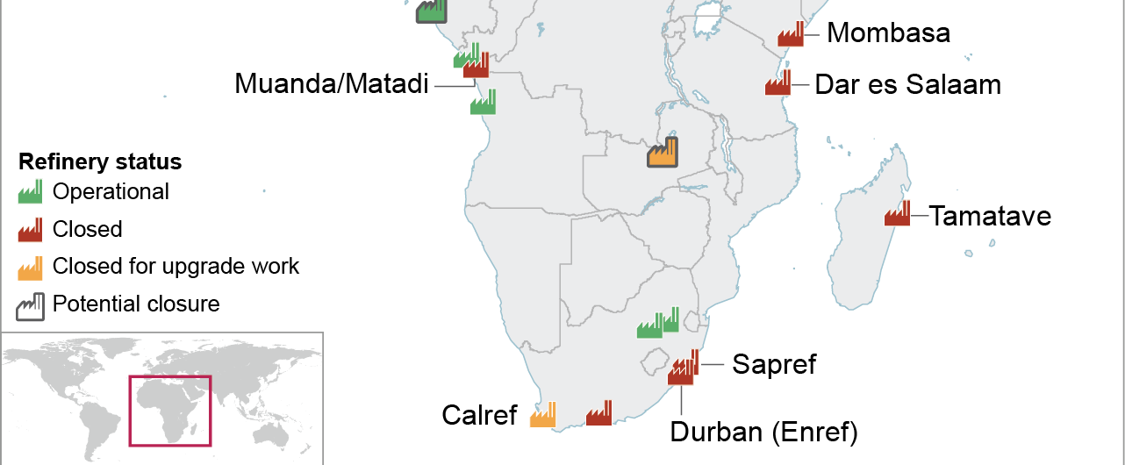
Regional refining capacity has contracted | All of coastal East Africa’s refineries have closed and there are no projects on the horizon
Indeni
Source: S&P Global Commodity Insights
Notes:
For this region the refining system has contracted in recent years and the region is increasingly dependent on imports

Slide 24
Net imports have surged and are set to grow further in the next decade
Notes:
Imports have doubled since 2020 and will grow further going forward

Slide 25
Supply risk? | Africa is heavily dependent on imports from Europe and the Middle East
Notes:
This means there’s a need for more focus on what’s happening in those supply regions
Gasoline is mostly coming from Europe
Gasoil mostly from the Middle East and India
What’s happening in these regions?

Slide 26
Closures coming | Almost two-thirds of global refining capacity is in regions where demand is set to fall over the next five years
Korea
Japan
China
Europe
North America
Notes:
Almost two-thirds of refining capacity is in regions where demand is contracting fast
That means there is pressure to close those assets
Two ways to see this; either there are going to be more refiners looking at Africa as an outlet for excess production, or some of the refineries that are supplying the region today are going to shut. It will probably be a bit of both but in any case it’s set to be disruptive

Slide 27
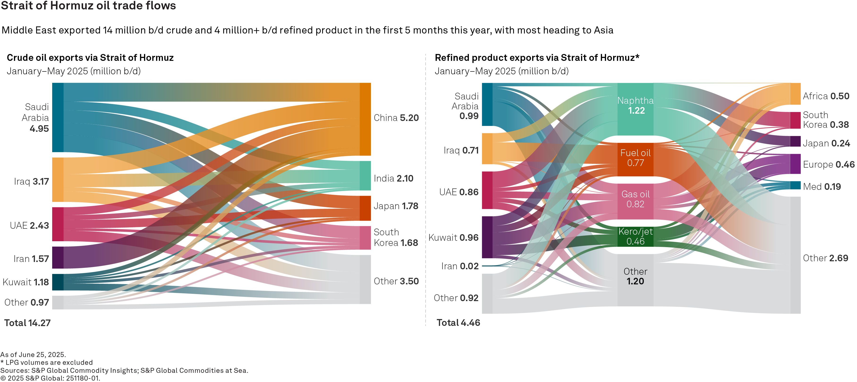
Geopolitical risk remains elevated | Africa is a big buyer of refined products from the Middle East
Notes:
The Middle east is a region that is adding capacity but it has it’s own issues
The chart of on the right shows that a big share of the gasoil coming into Africa is passing through Hormuz. That could be a risk

Slide 28
Urgent need for infrastructure | Demand growth in next 10 years will stretch already-stressed infrastructure
Mombasa supply zone
Change from 2025-35
Demand: +28%
Tankers in the port: +6 per month
Trucks on the road: +110,000 per year
M
Dar es Salaam supply zone
Change from 2025-35
Demand: +42%
Tankers in the port: +4 per month
Trucks on the road: +75,000 per year
D
B
Beira supply zone
Change from 2025-35
Demand: +38%
Tankers in the port: +3 per month
Trucks on the road: +50,000 per year
Demand includes naphtha, gasoline, gasoil, jet/kero and fuel oil. Mombasa supply zone includes Kenya, South Sudan, Sudan and Uganda. Dar es Salaam supply zone includes Buriundi, 10% of DRC, Rwanda, Tanzania and 50% of Zambia. Beira supply zone includes: 10% of DRC, Malawi, 80% of Mozambique, 50% of Zambia and Zimbabwe.Assumes MR for tankers and 40,00 liter tanker truck.
Source: S&P Global Commodity Insights
Notes:
In addition to changes in where supply is coming from there are going to be constraints on the supply chain
There are few import locations and they’re going to be more heavily utilized as imports increase
Unless there’s investment, congestion will increase
So there’s a need to create more robust, resilient supply chains and also consider how to diversify supply to mitigate the risk of disruption

Slide 29
Has the energy transition stalled?

Slide 30
The South African view | Energy transition matters…but not as much as other issues
All FIASA members think energy transition matters
But other issues are more important right now
Notes:
Although it’s a good time to reevaluate, it’s important to realize that this is still an important issue for govts, consumers and companies and it’s not something that should be ignored.
It just needs to be viewed together with other strategic initiatives so that the trade offs can be better-appreciated.
How do you balance energy transition objectives or commitments versus investing in the base business?

Slide 31
The energy transition is being reset | Shift in global geopolitics is driving a reevaluation of how decarbonization competes with other priorities
The cost and complexity of an unpresented energy transition are becoming apparent
1
A
Security: Energy security is national security
More focus on national resources
B
2
Reassessment of what is strategic
Affordability: Energy dominance is economic dominance
3
C
Less appetite for high cost, low carbon options
Sustainability: Yes…but not at any cost
Notes:
The world in which decarbonization targets were set and energy transition strategies were developed is no more.
More nationalistic/protectionist geopolitics is leading to a reassessment of what is strategic…often supporting fossil fuels.
Greater number of competing priorities are resulting in less support for the most costly decarbonization technologies.

Slide 32
Policy versus technology | Focus on cost-competitiveness is increasing as concern about policy stability rises
Cost Compression
Low Carbon Alternative
Gap for policy to bridge
Carbon Cost Increase
3
Greater focus on cost-competitiveness
Cost ($/b)
Fossil Fuel
2
Less willingness to rely on policy to support business cases
1
Growing concern about support low carbon alternatives will get from rising carbon prices
Notes:
Focus has shifted to cost competitiveness as concern about the stability of the policy environment has dwindled

Slide 33
Technology outlook | While there is a path to competitiveness for several key technologies, others will continue to rely on policy support
Competitive today
Competitive by 2040
Requiring policy support in 2040
Wind
Solar
Wind
Solar
EVs
CCS
Wind
Solar
EVs
CCS
Biofuels
PTL
Hydrogen fuel cells
Notes:
Need for continued policy support for biofuels, PTL and H2 is leading to a significant reduction in projects.

Slide 34
A slower goodbye | We expect global oil demand to plateau from 2025-2035
Source: S&P Global Commodity Insights.
Annual Strategic Workbook: Preliminary Outlook 2025
© 2025 S&P Global

Slide 35
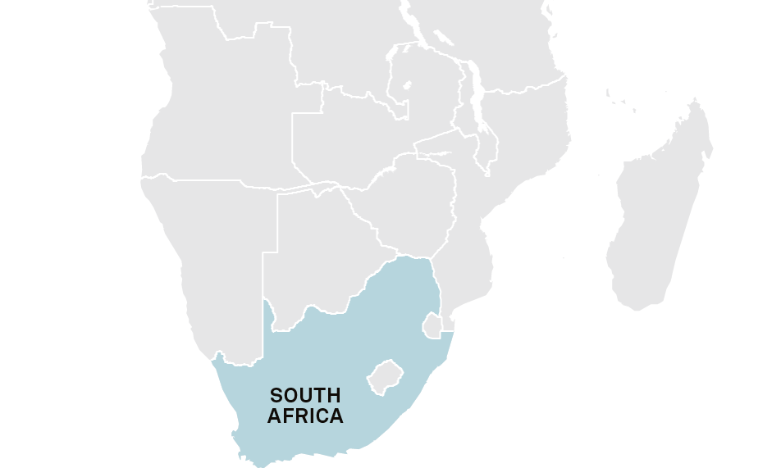
Reconciling global, regional and local dynamics creates a strategic challenge
Global picture is becoming more fragmented, with investment for alternative fuels and some technologies slowing.
Regional focus is on a just transition with many countries advocating for economic growth on the back of fossil fuel production and consumption.
South Africa is straddling multiple paths: Net zero goals, carbon pricing, decarbonization objectives, supply security, competing economic objectives, availability of alternative fuels
Notes:
SA presents some specific challenges which make navigating the ET a difficult proposition
In a way, SA is straddling the developed and developing world.
The ET cannot be ignored (like Moz might), but the social, economic and political context are not suited to going flat out like EU.
A multidimensional ET should be an opportunity (mining activity + strong oil demand growth), but it often seems like a burden.
Low cost ET options probably won’t work in SA so need to focus on getting a more supportive regulatory environment for low CI fuels

Slide 36
The need for regulatory support | Can alternative fuels be cost-competitive?
Data compiled Oct. 2, 2024.
*Indicative costs
Source: S&P Global Commodity Insights.
© 2024 S&P Global.
Notes:
Is scaling alternative fuels viable?
Only with cost de-escalation or policy support
We don’t think biofuels costs can fall
Efules cost can fall but can they fall far enough?
A big uncertainty is around Chinese investments in electrolysers. Project developers are signalling they believe in a solar/wind style cost reduction.
If not, policy support will be required…but will that be enough?

Slide 37
Final thoughts

Slide 38
Final thoughts
1
Sub-Saharan Africa will be the fastest-growing, most resilient market for transportation fuels in the decades to come
2
Meeting that demand will require substantial investment in building more resilient, cross-border fuel supply chains
3
Moving forward with the energy transition requires a stable regulatory environment and a strategic reconciliation with the need to keep investing in conventional fuels

