Slide 1

Global and Africa outlook on LPG
Fernando Covas / NGLs / Executive Director &
Lead for Europe, CIS, and Africa
South African Fuels Forum
July 24, 2025

Slide 2
Topics for today’s discussion
1
What are the macro trends in global markets?
2
What is the effect of geopolitics?
3
What is the outlook for Africa?

Slide 3
What are the macro trends in global markets?

Slide 4
North America will continue to be the largest supplier of LPG, even if Middle East is starting to grow after years of production constraints
Global Propane Supply by Region
(Thousand metric tons)
Global Butane Supply by Region
(Thousand metric tons)
Asia
14.5%
Africa
Africa
15.0%
Average 15,478
Average 14,618
29.9%
Asia
Middle East
20.6%
30.7%
Europe
19.7%
18.9%
CIS
Middle East
18.6%
Europe
CIS
47.0%
North America
41.6%
30.4%
North America
4.8%
4.4%
Latin America
22.8%
Latin America
Oceania
4.4%
3.6%
Oceania
Jan 21
Mar 21
May 21
Jul 21
Sep 21
Nov 21
Jan 22
Mar 22
May 22
Jul 22
Sep 22
Nov 22
Jan 23
Mar 23
May 23
Jul 23
Sep 23
Nov 23
Jan 24
Mar 24
May 24
Jul 24
Sep 24
Nov 24
Jan 25
Mar 25
May 25
Jul 25
Sep 25
Nov 25
Jan 26
Mar 26
May 26
Jul 26
Sep 26
Nov 26
Jan 21
Mar 21
May 21
Jul 21
Sep 21
Nov 21
Jan 22
Mar 22
May 22
Jul 22
Sep 22
Nov 22
Jan 23
Mar 23
May 23
Jul 23
Sep 23
Nov 23
Jan 24
Mar 24
May 24
Jul 24
Sep 24
Nov 24
Jan 25
Mar 25
May 25
Jul 25
Sep 25
Nov 25
Jan 26
Mar 26
May 26
Jul 26
Sep 26
Nov 26
Data compiled June. 30, 2025.
Notes: Global demand/supply estimates based on monthly STO and ASW reports (July 2024). Global demand/supply balance is based on the latest monthly regional outlooks. Natural Gas supply includes other supplies, such as net storage withdrawals.
Source: S&P Global Commodity Insights

Slide 5
The residential and commercial sectors are growing, but feedstock demand for petrochemicals has grown faster
Global Propane Demand by Source
(Thousand metric tons per month)
Global Butane Demand by Source
(Thousand metric tons per month)
Residential and Commercial
Chemical: Base Cracking
Refinery
Residential and Commercial
Chemical: BDH
Refinery
Industrial
Chemical: PDH
Other Demand
Industrial
Chemical: MTBE
Other Demand
Engine Fuel
Manufactured Gas
Chemical: Price-Sensitive
Engine Fuel
Chemical: Maleic Anhydride
Chemical: Price-Sensitive
+4.2%
Chemical: Base Cracking
Manufactured Gas
15,793
-0.3%
14,666
15,486
16,132
14,232
13,926
15,031
+2%
13,170
13,813
13,972
14,187
13,562
13,639
14,221
12,579
12,940
+2%
12,525
12,820
43%
11,750
11,838
12,194
12,322
11,851
44%
42%
43%
11,143
46%
45%
44%
46%
47%
48%
48%
49%
48%
46%
45%
45%
48%
47%
46%
46%
48%
46%
47%
46%
22%
21%
21%
21%
15%
15%
15%
16%
19%
20%
19%
20%
22%
15%
14%
14%
13%
13%
14%
15%
15%
22%
21%
20%
8%
8%
9%
10%
11%
11%
12%
13%
16%
16%
16%
12%
12%
13%
13%
11%
12%
12%
13%
13%
13%
12%
12%
2015
2016
2017
2018
2019
2020
2021
2022
2023
2024
2025
2026
2015
2016
2017
2018
2019
2020
2021
2022
2023
2024
2025
2026
Data compiled June. 30, 2025.
Notes: Global demand/supply estimates based on monthly STO and ASW reports (July 2024). Global demand/supply balance is based on the latest monthly regional outlooks. Natural Gas supply includes other supplies, such as net storage withdrawals.
Source: S&P Global Commodity Insights

Slide 6
Additional PDH units are expected to become operational and LPG cracking will grow in mainland China, even with the current headwinds
27.1
6
Data compiled June. 2025.
Source: S&P Global Commodity Insights.

Slide 7
What is the effect of geopolitics?

Slide 8





Uncertainty is not confined to trade and tariffs
Many “anchors” of the pre-pandemic period have become more uncertain
Geopolitical shifts
US protectionism
Faltering alliances
Role of the dollar
Return of inflation
Supply disruptions
Tariff effects
Sticky services prices
Higher interest rates
Leaning against inflation
End of ultra-low policy rates
Rise in term premia
Fiscal fragilities
High debt and deficits
Political instability
Unwinding of quantitative easing

Slide 9
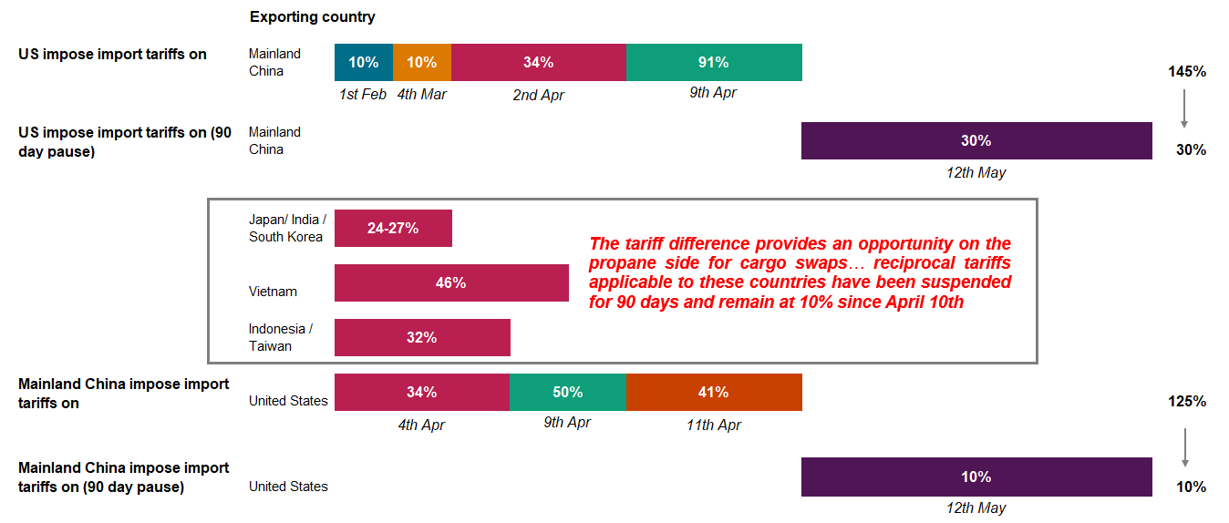
US tariffs on imports have disrupted global LPG flows significantly, and the 90-day pause (expiring in August) does not guarantee a return to “normal”
2025 Timeline of US import tariffs
Data compiled June 2025
Source: S&P Global Commodity Insights.
© 2025 S&P Global.

Slide 10
LPG exports to China from the US have collapsed since April
Data compiled Jul. 23, 2025
Source: S&P Global Commodity Insights, Commodities at Sea.
© 2025 S&P Global.

Slide 11
Amid these tensions, a temporary two-tiered LPG market emerged, as some Chinese importers opt to swap for Gulf cargoes, firming up Saudi CP prices
Data compiled June 2025
Source: S&P Global Commodity Insights.
© 2025 S&P Global.

Slide 12
VLGC rates have risen due to the Middle East unrest and the sub-optimization of trade routes from tariffs; we expect a slight easing if the ceasefire holds
Ocean Freight Costs: VLGCs ($/metric ton)
Houston → Chiba
Houston → Flushing
Ras Tanura → Chiba
Annual Average | 2024 | 2025 | 2026
Houston → Chiba | 114 | 114 | 119
Houston → Flushing | 63 | 63 | 68
Ras Tanura → Chiba | 63 | 60 | 73
+17.8%
-1.7%
Jan-20
Jul-20
Jan-21
Jul-21
Jan-22
Jul-22
Jan-23
Jul-23
Jan-24
Jul-24
Jan-25
Jul-25
Jan-26
Jul-26
Jan-27
Data compiled June. 30, 2025.
Source: S&P Global Commodity Insights
© 2025 S&P Global.

Slide 13
What is the outlook for Africa?

Slide 14
Southern African LPG demand has grown tremendously, with most imports now coming from the USA
Data compiled Jul. 23, 2025.
Demand data above includes Botswana, Lesotho, Namibia, Zimbabwe, and South Africa. Trade data above includes Namibia and South Africa. In 2018 and 2019, Indonesia and Argentina were important suppliers to Southern Africa. Others includes Argentina, Indonesia, Australia, South Africa, Russia, Togo, Norway, Trinidad & Tobago, Ghana, US Virgin Islands, Tanzania, and others. Middle East includes Qatar, Saudi Arabia, Iraq, Oman, and the UAE.
Sources: S&P Global Commodity Insights, Commodities at Sea.
© 2025 S&P Global.

Slide 15

Joint WLGA/S&P Global LPG Roadmap for Africa shows the potential for Africa’s LPG demand growth rate to exceed Asia, with huge societal benefits
Source: S&P Global Commodity Insights.
© 2025 S&P Global
https://www.worldliquidgas.org/wp-content/uploads/2024/12/LPG-Roadmap-for-Africa.pdf

Slide 16
Local prices in South Africa reflect global trends, but not the near-term realities of pricing in the US Gulf Coast, which is the region’s largest supplier
Data compiled Jul. 23, 2025.
Sources: S&P Global Commodity Insights, DMRE.
© 2025 S&P Global.

Slide 17
In the long term, we expect propane prices will increase as petrochemical demand recovers and supply growth slows down
Data compiled Jul. 23, 2025.
Sources: S&P Global Commodity Insights.
© 2025 S&P Global.

Slide 18
Disclaimer

