Slide 1
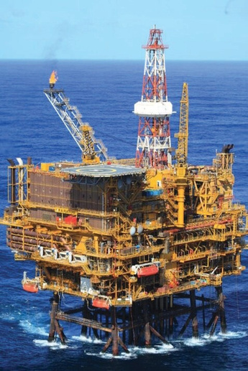

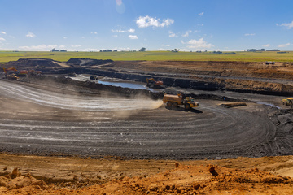
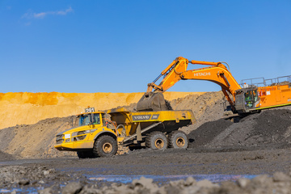



DMPR
DEPARTMENT OF MINERAL AND PETROLEUM RESOURCES
FUEL PRICNG MECHANISM IN
SOUTH AFRICA
Presented by: ROBERT MAAKE
Slide | 01

Slide 2
Outline
DMPR
Petrol, LPGas and IP prices are regulated
Basic Fuel Price (BFP) Working Rules
Regulatory Accounting System (RAS)
Composition of the pump price
Emerging Risks
Maximum Refinery Gate Price (MRGP)
Maximum Retail Price
Conclusion
Presented by: ROBERT MAAKE
Slide | 02

Slide 3
Policy Framework
DMPR
Determination of the fuel prices
  Petrol, LPGas and illuminating paraffin (IP)
  Diesel prices are not regulated
Import parity principle (IPP) applies
Dfn: The price an importer pays to purchase a product in the world market and have it delivered for domestic sale.
  Deemed pricing
  Zonal pricing – magisterial district zones (MDZ)
  Transport modes – based on least cost mode
  Cost recovery - Pass through cost
Presented by: ROBERT MAAKE
Slide | 03

Slide 4
Basic Fuel Price (BFP)
DMPR
The Basic Fuel Price (BFP) is based on the import parity pricing principle i.e. what is would cost a South African importer of petrol to buy the petrol from an international refinery, transport the product from that refinery, insure the product against losses at sea and land the product on South African shores.
NB: The Central Energy Fund (CEF) (Pty) Ltd was appointed by Cabinet in 1994 as an impartial body to determine BFP’s (prevent manipulation by any interested party)
Daily and average monthly BFP’s for price regulated fuels are calculated by (CEF) in terms of the Working Rules to administer the BFP
Monthly BFP calculations, price changes to be effected and monthly Fuel Price Media Statement audited by independent auditors appointed by the Department.
Slide | 04

Slide 5
BFP Working Rules
DMPR
Make provision for all grades of petrol, all grades of diesel and illuminating paraffin (IP)
BFP to be adjusted on the first Wednesday of a month
Over/under recoveries incurred in a fuel price review period will be cleared in the next one
Important months
April – transport tariffs, fuel levy and RAF adjustments
September – Forecourts attendants wage adjustments - MIBCO
December – wholesale and retail margins adjustments including secondary storage and transport – Regulatory Accounting System (RAS).
Quarterly – Octane differential adjustments
Presented by: ROBERT MAAKE
Slide | 05

Slide 6
DMPR
Elements of the BFP
Free-on-Board (FOB)-value – cost of fuel in the markets
Freight and Average Freight Rate Assesment – shipping costs
Insurance
Ocean loss – evaporation during transportation
Demurrage – 3 days provision for offloading of fuel
Cargo Dues – a fee to use the harbour facilities (by TNPA)
Coastal Storage – 25 days provision to ensure security of supply
Stock Financing costs – at prime rate minus 2
Presented by: ROBERT MAAKE
Slide | 06

Slide 7
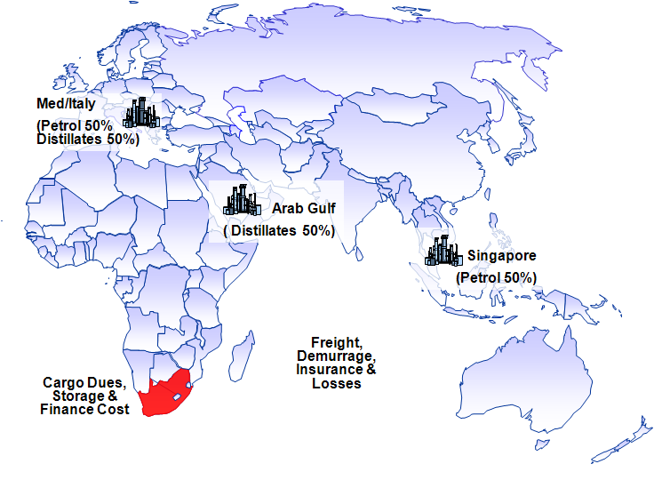
Reference Markets
DMPR
Presented by: ROBERT MAAKE
Slide | 07

Slide 8
Factors that influence the BFP
DMPR
International crude oil prices
International product s/d balances
Product inventory level
Geo-politics e.g. Russia-Ukraine, Closure of Suez canal etc.
Rand/US Dollar exchange rate
International refining margins
Weather patterns in the Northern Hemisphere
Presented by: ROBERT MAAKE
Slide | 08

Slide 9
DMPR
Fuel Levies
Petroleum products levy: to reimburse the pipeline users for the applicable NERSA tariff on transporting fuel through the pipeline
IP Tracer dye levy: to reimburse the oil industry for buying IP tracer dye and to inject it into IP to curtail the mixing of IP and diesel (loss to the Fiscus)
Slate levy: to finance the cumulative under recovery of the industry. Only applicable when the cumulative Slate balance exceeds R500 million (under recovery)
Fuel levy: Tax levied by Government (Minister of Finance)
Custom and Exercise levy: a duty collected in terms of the Customs Union Agreement
Road Accident Fund (RAF) levy: To compensate for people involved in vehicle accidents.
Presented by: ROBERT MAAKE
Slide | 09

Slide 10
DMPR
Regulatory Accounting System (RAS)
Margins on activities are based on Regulatory Accounts
Activities post-refinery gate are ring-fenced
Assets, costs and ROA are ring-fenced to that activity – ABC methodology
CAPM and WACC are applied to determine the ROA of each activity
Identified activities were:
  Wholesale activities
  Secondary storage
  Secondary distribution
  Service station retail activities (BSS)
Presented by: ROBERT MAAKE
Slide | 10

Slide 11
Pump price make-up in SA
DMPR
 | Petrol 95 ULP | Petrol 93 ULP & LRP | Diesel 0.05% S | Diesel 0.005% S | Illumi- nating Paraffin
 | c/l | c/l | c/l | c/l | c/l
Wholesale margin | 73,700 | 73,700 | 94,990 | 94,990 | 94,990
Secondary Storage | 38,000 | 38,000 | 38,000 | 38,000 | 38,000
Secondary Distribution | 18,800 | 18,800 | 18,800 | 18,800 | 18,800
Router Differential | 0,000 | 0,000 | 0,000 | 0,000 | 7,400
Retail margin | 299,500 | 299,500 | 0,000 | 0,000 | 0,000
Zone differential in Gauteng | 87,100 | 87,100 | 87,100 | 87,100 | 105,300
IP Tracer levy | 0,000 | 0,000 | 0,500 | 0,500 | 0,000
Fuel levy | 415,000 | 415,000 | 402,000 | 402,000 | 0,000
Customs & excise duty | 4,000 | 4,000 | 4,000 | 4,000 | 0,000
RAF levy | 218,000 | 218,000 | 218,000 | 218,000 | 0,000
Petroleum Products levy | 0,330 | 0,330 | 0,330 | 0,330 | 0,000
Slate levy | 0,000 | 0,000 | 0,000 | 0,000 | 0,000
Pump Rounding | ( 0,300) | ( 0,300) | 0,000 | 0,000 | 0,000
Sub-total | 1 154,130 | 1 154,130 | 863,720 | 863,720 | 264,490
Contribution to the Basic Fuel Price | 1 032,870 | 1024,870 | 1 071,630 | 1 077,030 | 1 051,128
Retail Price | 2 187,00 | 2 179,00
Slide | 11

Slide 12
Emerging risks
DMPR
Security of supply threatened by the closure of refineries
Inability to supply fuel to SACU region
Conversion of manufacturing warehouse to depots may affect the collection of DAS
Transportation of fuel from Richards bay by road could threaten the sustainability of the pipeline and lead to price arbitrage
Increasing fuel imports from Matola
How can we turn some of these risks into opportunities?
Presented by: ROBERT MAAKE
Slide | 12

Slide 13
Maximum Refinery Gate Price (MRGP)
DMPR
Use Impot Parity Principle since July 2020
Saudi Aramco determines the prices of Propane and Butane monthly
Based on freight from Ras Tanura in Saudi Arabia to Richards Bay
Vessel size used is 20kt
Challenges of landing LPGas at the Port of Saldanha Bay (5.5kt) are well documented
The Department implemented a 14% Supply Cost Recovery as an interim measure for 24 months
Presented by: ROBERT MAAKE
Slide | 13

Slide 14
Maximum Retail Price
DMPR
The MRP include amongst others, but not limited to the following
  Operating Expenses
  Working Capital
  Depreciation
  Gross margin – cylinder filling plant
Challenges
  Cylinder deposits – legal opinion
  Retail margin linked to MRGP
The Department has initiated a process to review all the elements of the MRP
Presented by: ROBERT MAAKE
Slide | 14

Slide 15
Conclusion
DMPR
The pump price of petrol is regulated in 54 MDZs
Diesel prices are not regulated
LPGas and IP are regulated at maximum prices
Fuel Pricing mechanism incorporates the Import Parity Principle (IPP)
The Petroleum market landscape is changing in SACU with the emergence of National Petroleum Companies
There is need to consolidate the SACU market
The department is monitoring the developments to ensure that the fuel pricing mechanism is robust
Presented by: ROBERT MAAKE
Slide | 15

Slide 16
DMPR
THANK YOU!
Raphi.maake@dmre.gov.za
Tel: +2712 444 3662
Mobile: +2782 773 2306
Presented by: ROBERT MAAKE
Slide | 16

