Slide 1
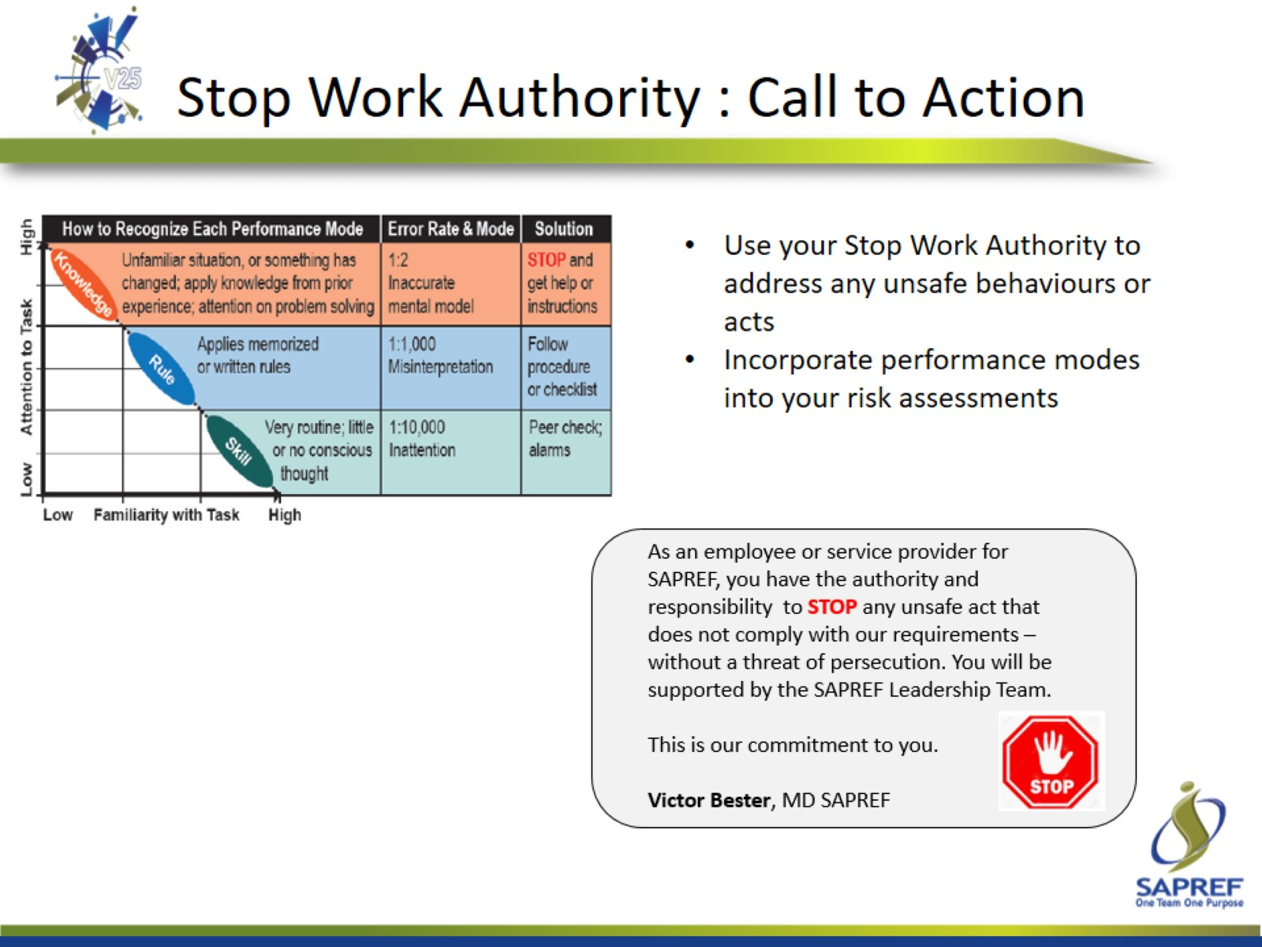
Stop Work Authority : Call to Action

